Slide 1
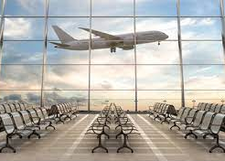
^{AIRBOURNE}
THE EFFECTS OF COVID ON TRAVEL

Slide 2
TEAM MEMBERS
Delfrieda mcknight
Jacqueline THOMPSON
JOAN Izundu
SHEILA CAVAZOS
TENISHA THOMPSON

Slide 3
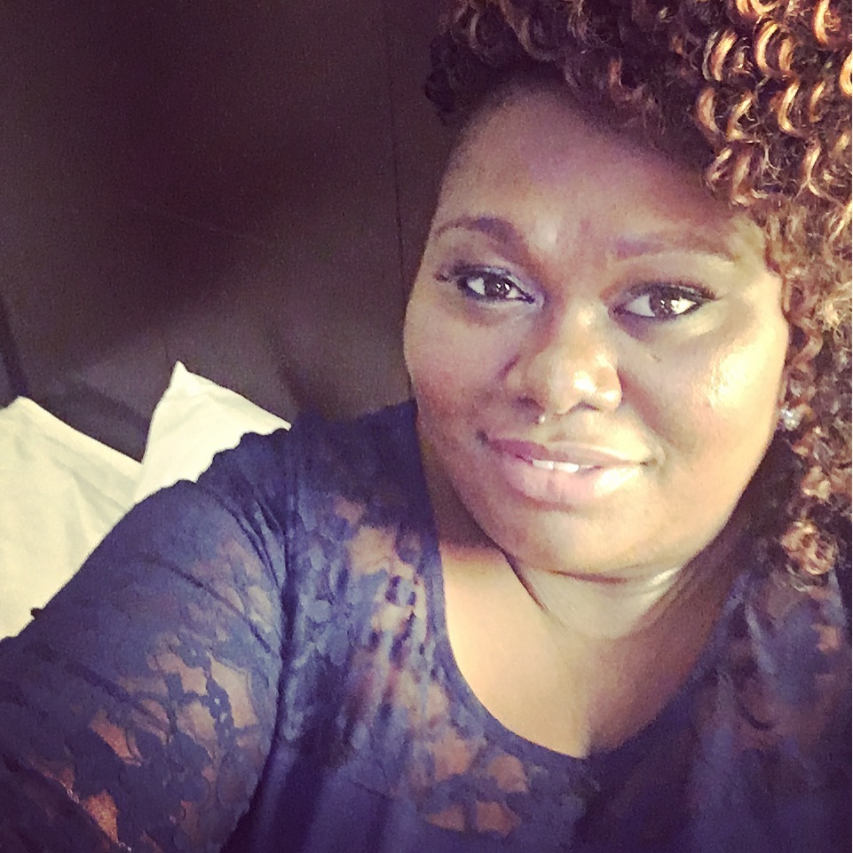
Delfrieda (Frieda) mcknight
Currently employed as a Fiscal analyst for Scdhhs (Medicaid)
Employment background: finance insurance, medical claims
Strengths: team player, trello, tableau
Hobbies: listenING to podcast, makeup and traveling
Interesting fact: I wanted to be a dental hygienist but realized I didn’t want to touch people

Slide 4
Jacqueline (JACKIE) THOMPSON

Slide 5
JOAN (JUNI) Izundu

Slide 6
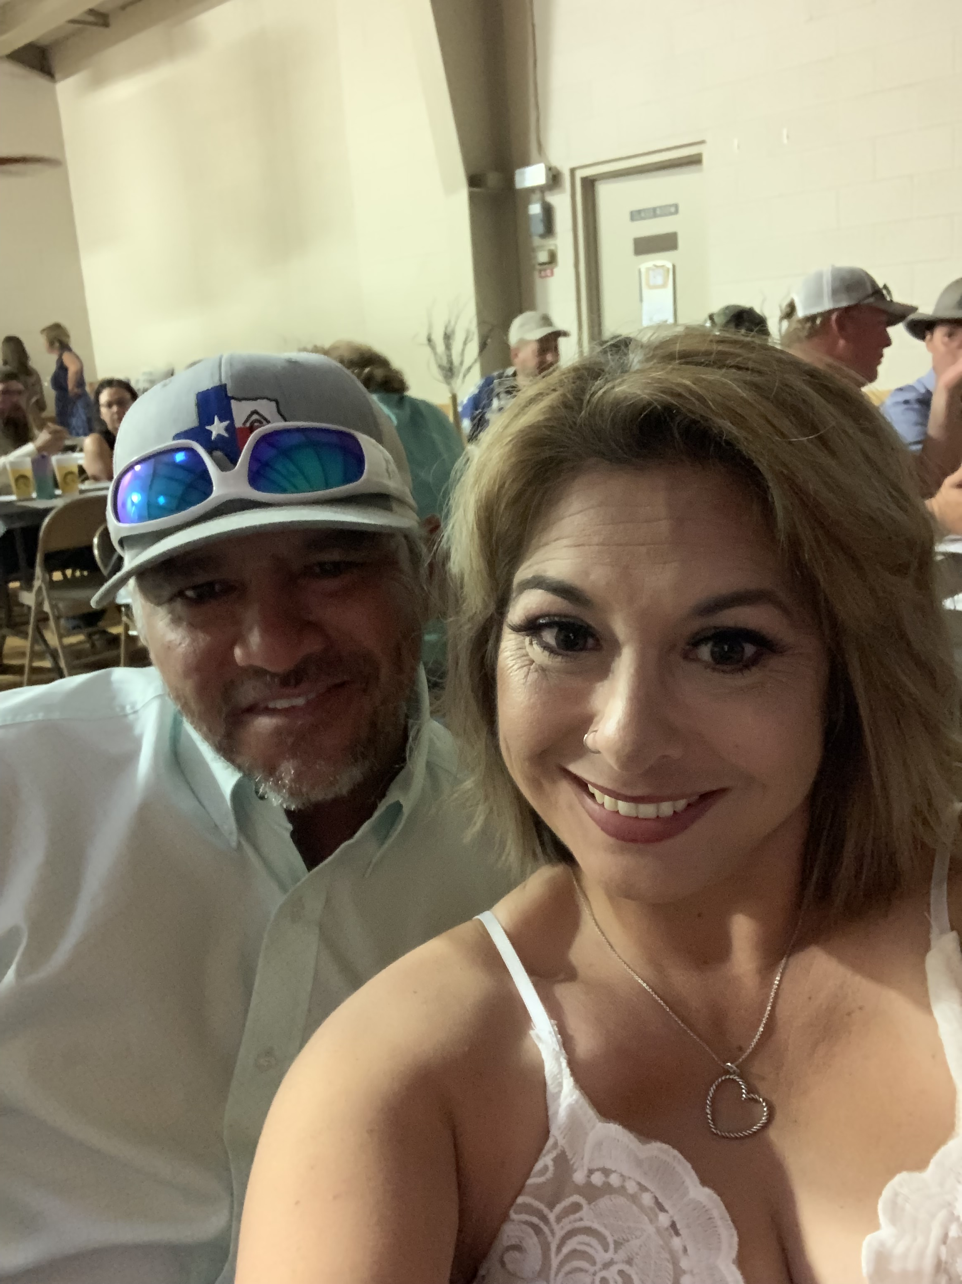
Sheila cavazos
Currently employed as a Credit Dispute Investigator
Employment background: Sales, insurance and data entry
Strengths: visualizations, graphics and python, tableau
Hobbies: reading, hiking, running, and being outdoors
Interesting fact: I live on a farm and raise pigs, COWS, AND CHICKENS

Slide 7
TENISHA THOMPSON

